Slide 1
NYPD Shooting incident Data report
Ryan Masad
2023-09-30

Slide 2
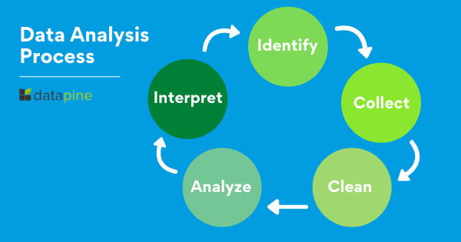
Agenda
Data Loading
Data Cleaning
Data Analysis
Conclusion

Slide 3
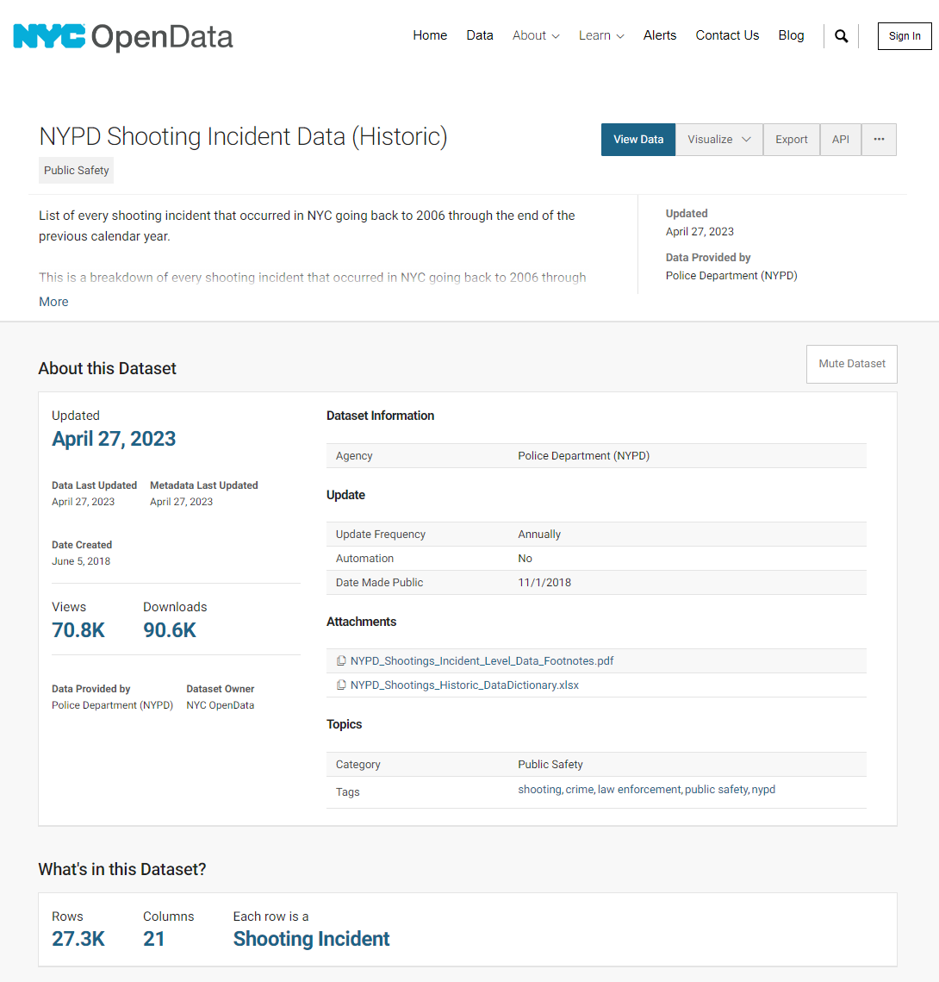
Data loading
Data obtained from NYC OpenData
NYPD Shooting Incident Data (Historic)
New York City Population by Borough, 1950 - 2040

Slide 4
What is our data
Notes:
Convert Date to a Date type variable
Create a column with Year, Month, and Monthly Date a.
This is needed because there isn't a shooting every day. So tracking trends over time seems more useful.
Convert STATISTICAL_MURDER_FLAG into a binary variable so we can sum it up to see how many murders occurred
4. Clean up the data set and remove unneeded columns. INCIDENT_KEY, TIME, PRECINCT, and JURISDICTION CODE do not seem necessary

Slide 5
Data Cleaning
Convert data to the correct data types
Decide on how to deal with nulls
Location
Perpetrator
Determine additional sources of Data
Population Dataset
Notes:
Location Data had a lot of nulls

Slide 6
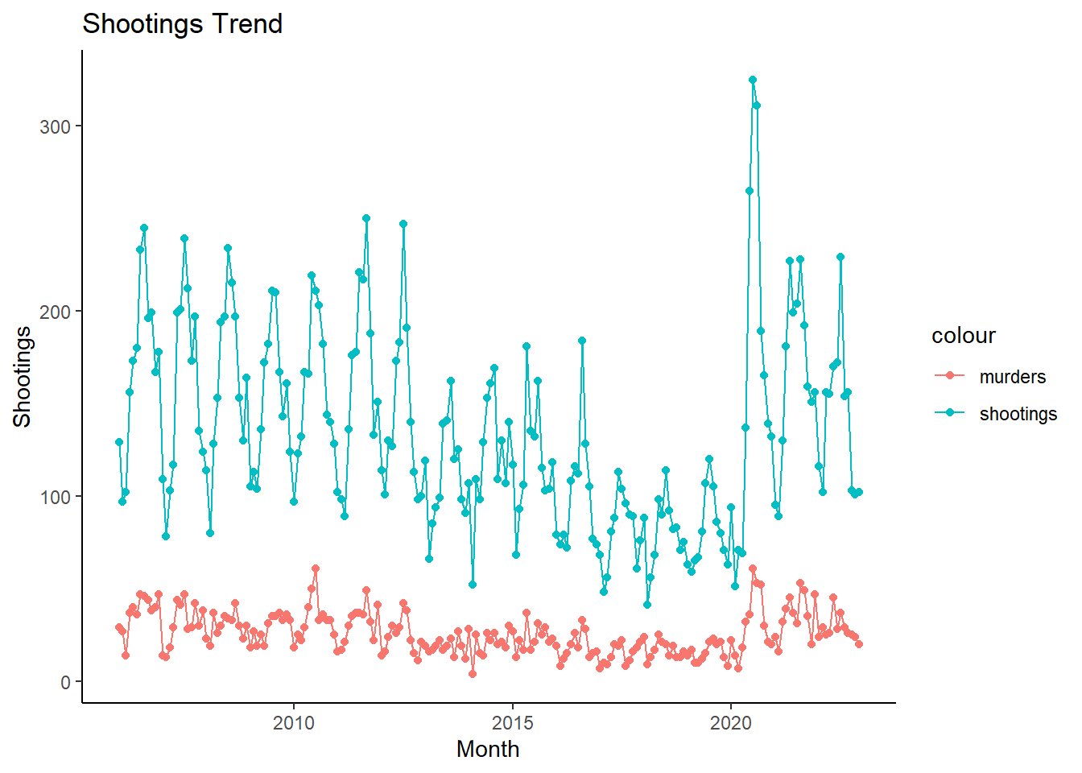
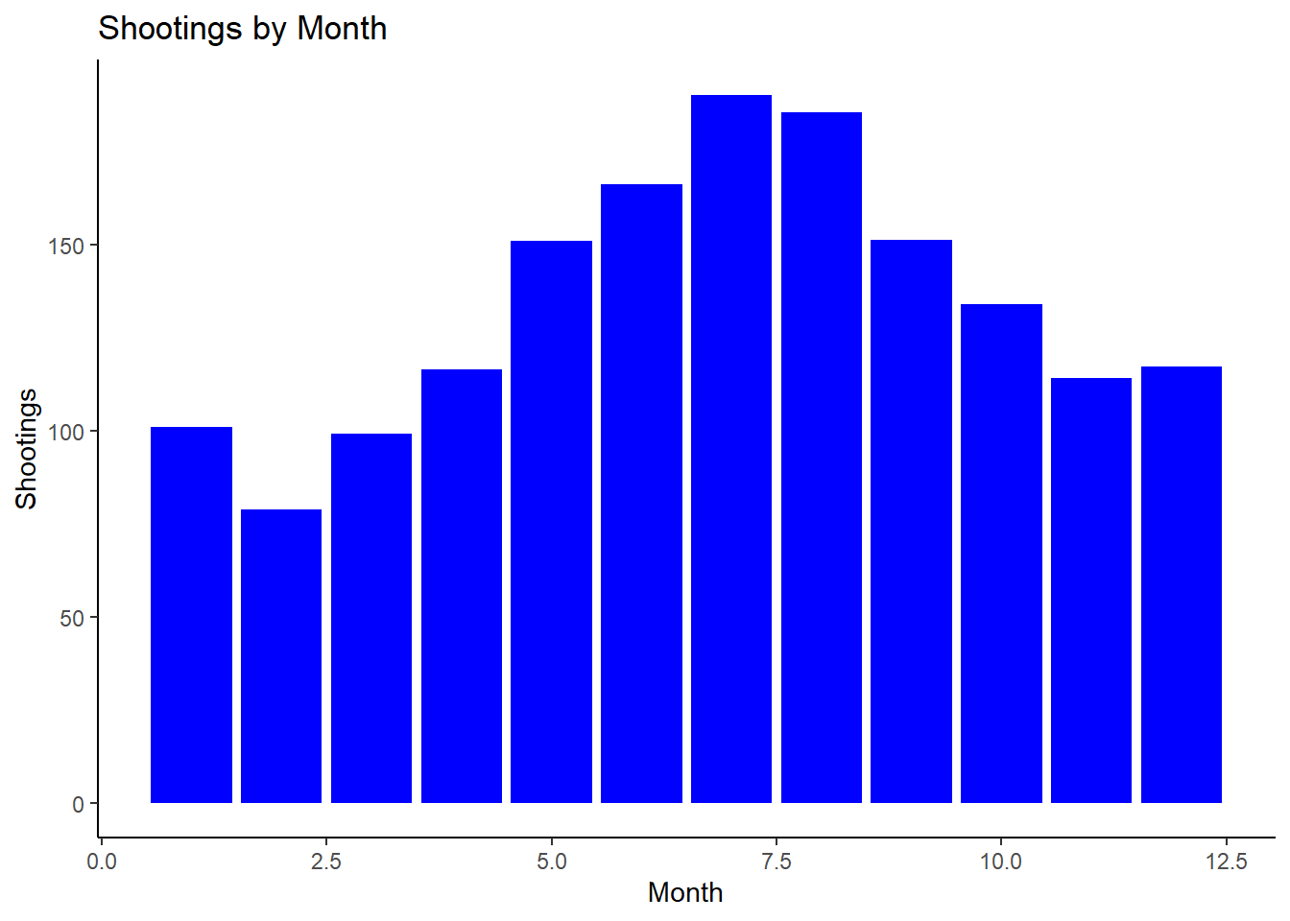
Data Analysis – New York Totals

Slide 7
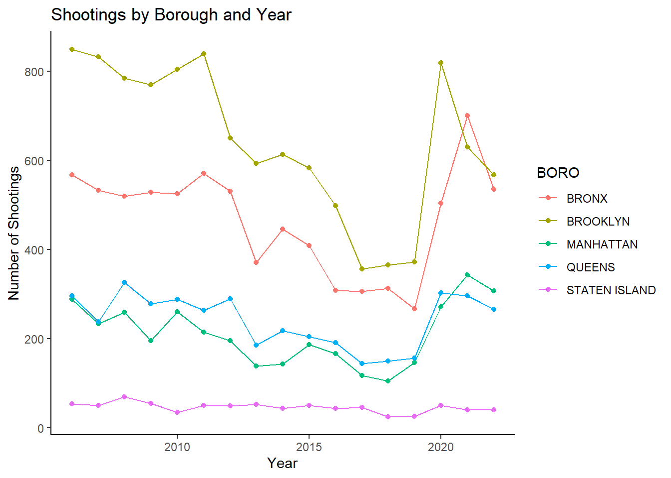
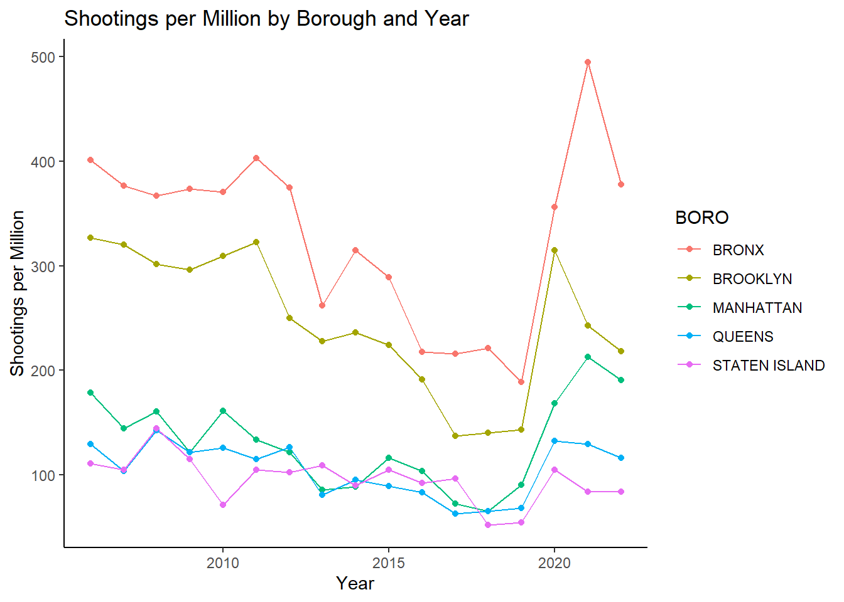
Data analysis – Borough shootings

Slide 8
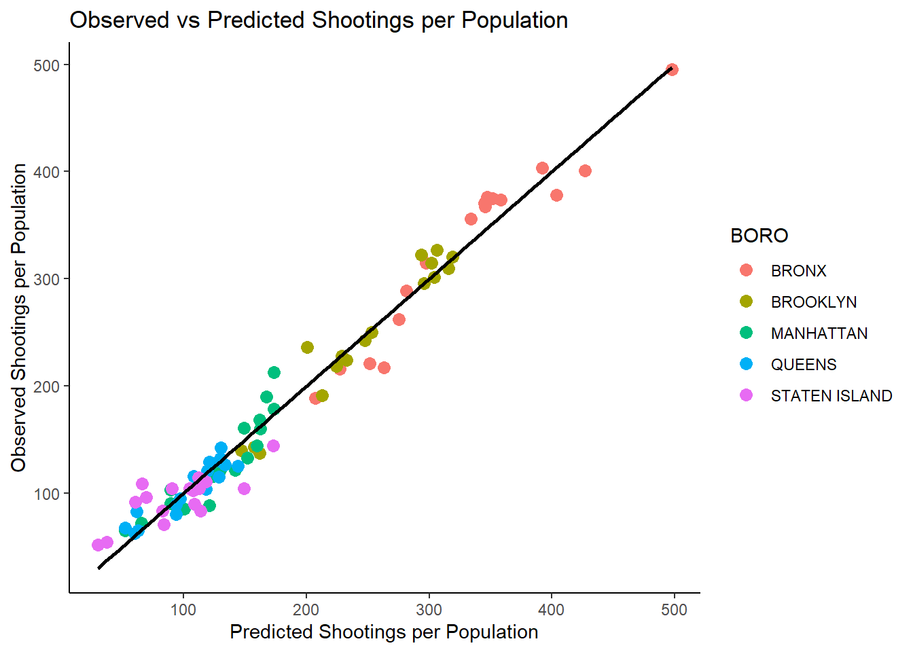
Shootings and murders correlation by boro
Correlation of shootings to murders
Adjusted R² = 96%
Data is very linearly correlated. No Borough really acts as an outlier.

Slide 9
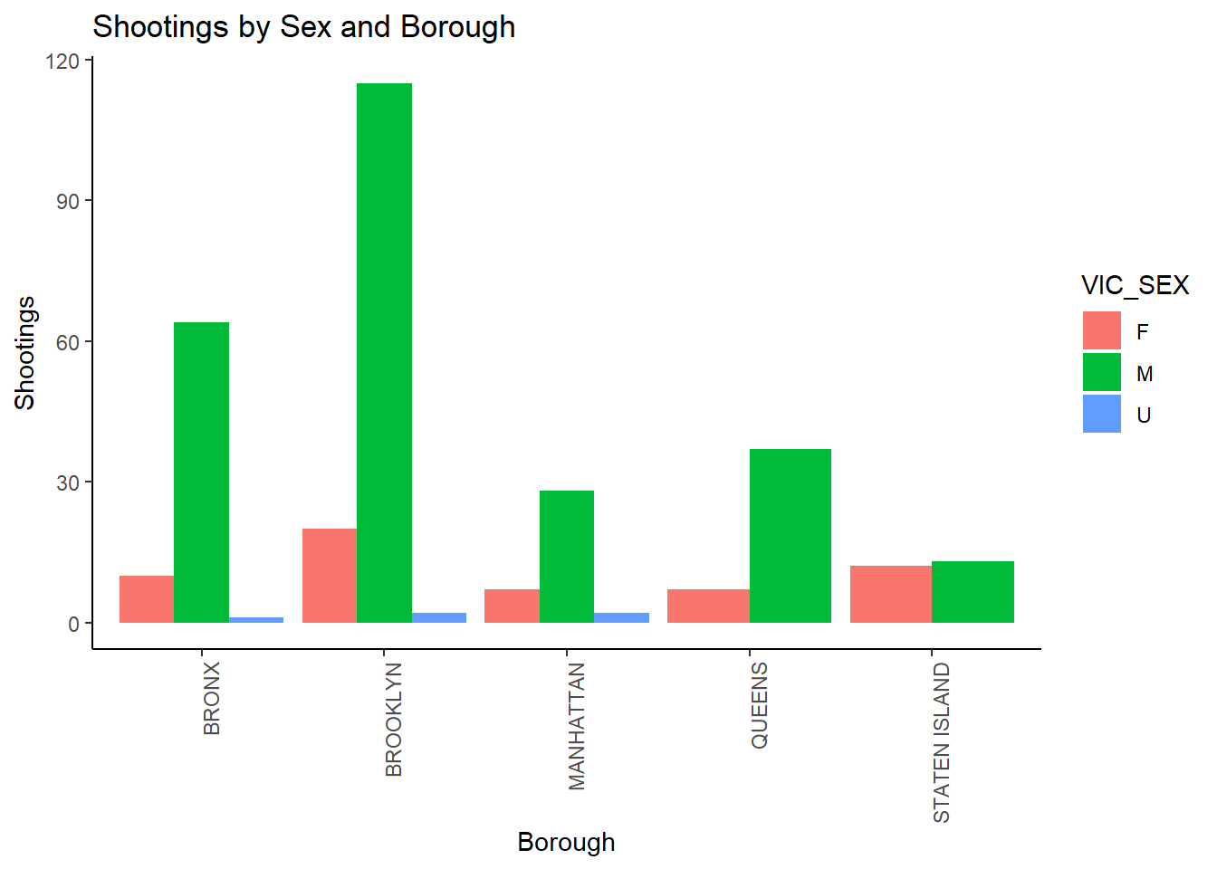
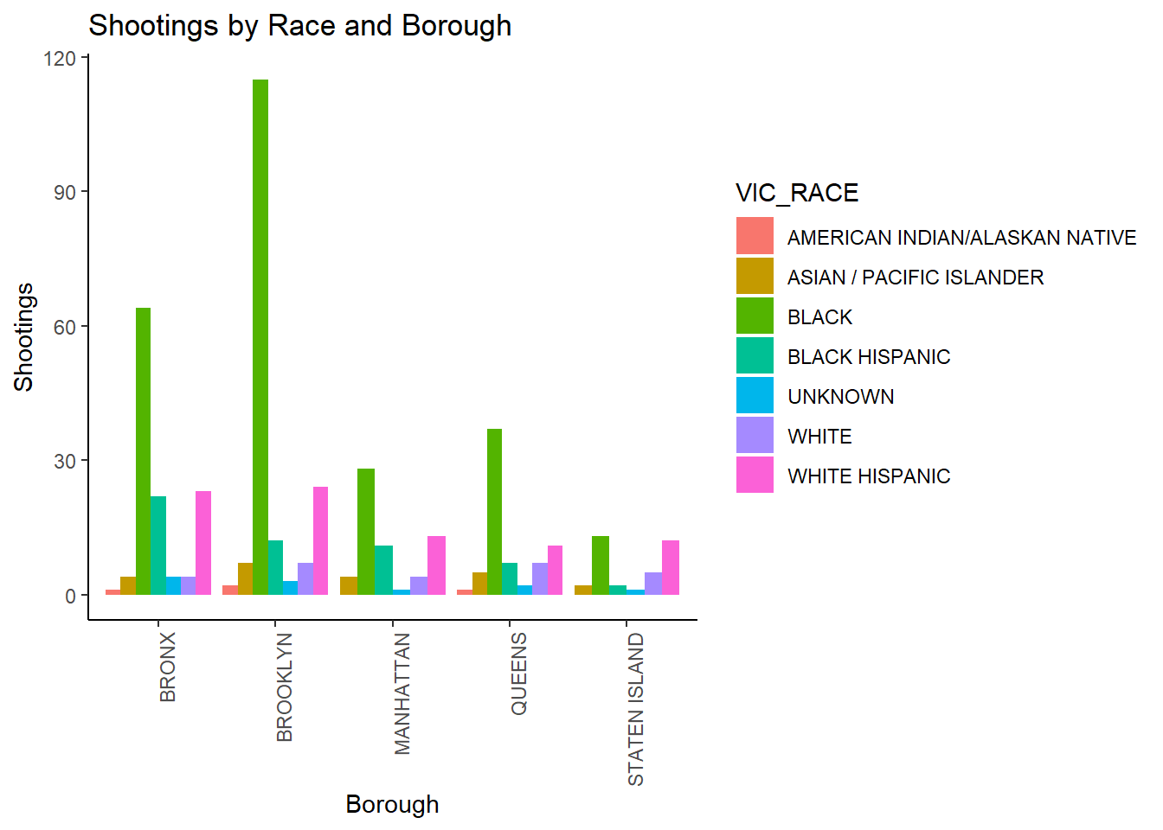
Data Analysis – continued

Slide 10
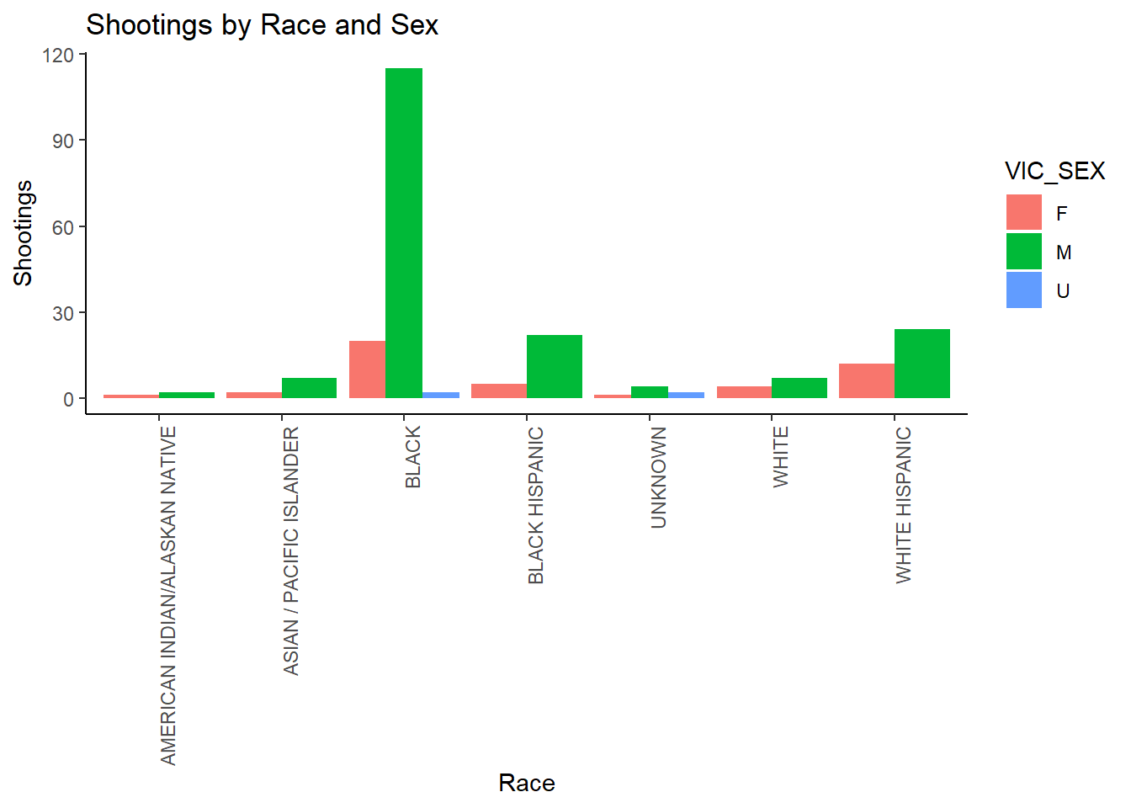
Data Analysis – continued
VIC_RACE | F | M | total | percent_male
AMERICAN INDIAN/ALASKAN NATIVE | 1 | 9 | 10 | 90.0%
ASIAN / PACIFIC ISLANDER | 38 | 366 | 404 | 90.6%
BLACK | 1756 | 17679 | 19435 | 91.0%
BLACK HISPANIC | 237 | 2409 | 2646 | 91.0%
UNKNOWN | 1 | 58 | 59 | 98.3%
WHITE | 118 | 580 | 698 | 83.1%
WHITE HISPANIC | 464 | 3585 | 4049 | 88.5%

Slide 11
Conclusion and Bias
New York Shootings Trending Down until 2020
Seasonality of Shootings
Why does spring and fall have so much less shootings then summer?
Race, Sex, and Borough Shooting Bias
Notes:
New York Shootings Trending Down until 2020
The spike of violent crimes write around 2020. This may not be representative of a Normal New York City, and may lead to a bad fitting model. We could remove this data, but that would also likely remove the return to pre improvement that New York was achieving.
Seasonality of Shootings
Why does spring and fall have so much less shootings then summer?
Race, Sex, and Borough Shooting Bias
Boroughs to shooting ratio. Some boroughs have much higher shootings. This could make a boroughs look significantly worse or better even if it isn’t. I chose to normalize the data by pulling in population to find the average shootings per million people.

